Slide 1
Verification and documentation
Verification Training 2019
Angie Hovatter
Director of Financial Aid, Employment and Scholarships
Frostburg State University
Laura Shahan
Assistant Director of Financial Aid
Chesapeake College

Slide 2
Agenda
What is Verification?
Overview of 2018-2019 Verification
Documentation
2019-2020 Verification
Case Studies/Group Discussion

Slide 3
Verification authority – Cfr
§668.51 General
(a) Scope and purpose. The regulations in this subpart govern the verification by institutions of information submitted by applicants for student financial assistance under the subsidized student financial assistance programs.
(b) Applicant responsibility. If the Secretary or the institution requests documents or information from an applicant under this subpart, the applicant must provide the specified documents or information.
(c) Foreign schools. The Secretary exempts from the provisions of this subpart participating institutions that are not located in a State.
Source 34 CFR 668.51

Slide 4
Verification authority – FAFSA
If you are the student, by signing this application you certify that you (1) will use federal and/or state student financial aid only to pay the cost of attending an institution of higher education, (2) are not in default on a federal student loan or have made satisfactory arrangements to repay it, (3) do not owe money back on a federal student grant or have made satisfactory arrangements to repay it, (4) will notify your college if you default on a federal student loan and (5) will not receive a Federal Pell Grant from more than one college for the same period of time.
If you are the parent or the student, by signing this application you certify that all of the information you provided is true and complete to the best of your knowledge and you agree, if asked, to provide information that will verify the accuracy of your completed form.
This information may include U.S. or state income tax forms that you filed or are required to file. Also, you certify that you understand that the Secretary of Education has the authority to verify information reported on this application with the Internal Revenue Service and other federal agencies. If you sign any document related to the federal student aid programs electronically using a FSA ID and Password. If you purposely give false or misleading information, you may be fined up to $20,000, sent to prison, or both.

Slide 5
What is verification?
The process used by colleges and universities to determine the accuracy and completeness of FAFSA information by comparing FAFSA results with documentation requested or already in the student’s file.
Starting in 2012-2013
Targeted selection of verification items (‘V’ Tracking Groups)
Elimination of 30% minimum – NOW must complete the process for every selected student
$400 tolerance eliminated – replaced with $25, NOW $0 Tolerance
Notes:
5 standard items: Household size, Number in college, Adjusted Gross Income (Student and Spouse or Parent), Taxes Paid, some untaxed income and benefits

Slide 6
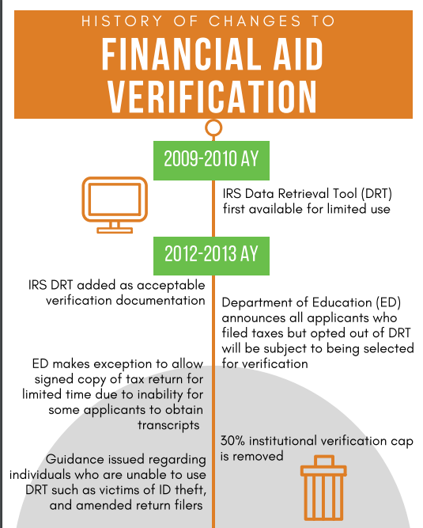
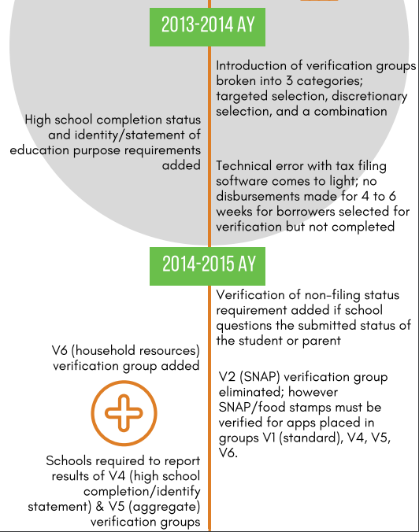
History of Verification process

Slide 7
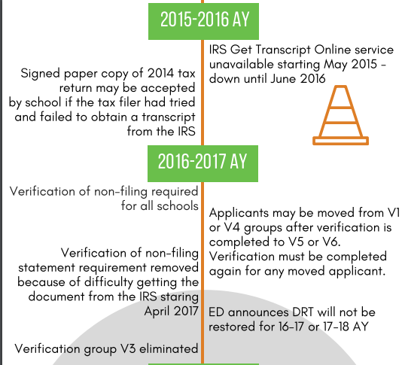
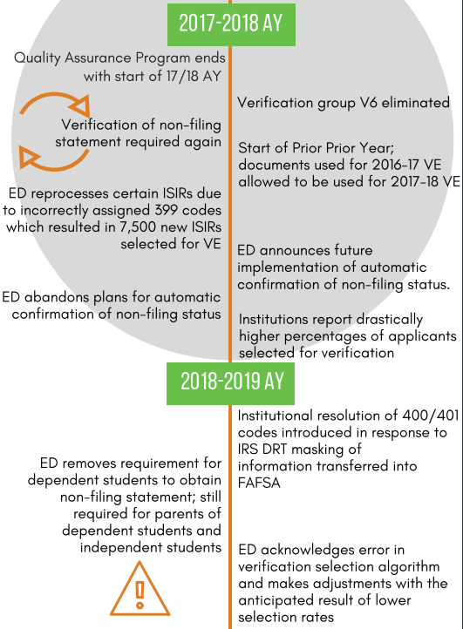
History of Verification process

Slide 8
History of Verification process

Slide 9
Who must be verified?
All students selected by CPS who will receive (or have received) Subsidized Financial Assistance (Pell, SEOG, FWS, Perkins & Direct Sub Loan)
Any information you have reason to believe is incorrect on any application, even if not selected by CPS
At school’s discretion, any student FAFSA information in accordance with consistently applied school policies
Professional Judgment – if selected, you must complete verification on the BASE YEAR before you adjust any values that are used to calculate the EFC.
Source: 2017-18 AVG 77

Slide 10
Notice to students
Required Policies and Procedures
Your school must have written policies about
the time period in which students must submit verification documentation,
the consequences for failing to submit those documents in time,
the method you will use to notify students if their EFC and Title IV aid amounts change,
the procedures you or students will follow to correct FAFSA data,
the procedure you will follow to refer a student to the Office of Inspector General (OIG)

Slide 11
Notice to students (cont.)
Your school must provide, in a timely manner, students selected for verification a clear explanation of their role, including what documents they must submit, the deadlines they must meet, and the consequences of failing to meet them.
Source: 2017-18 AVG 77

Slide 12
Verification Exceptions
Death of a student
Not an aid recipient – student not eligible for Title IV aid for reasons other than not completing verification. Example: Unsatisfactory SAP student
Applicant only eligible for unsubsidized aid
Verified by another school where documents can be obtained from that school
Post enrollment
Source: 2017-18 AVG 77

Slide 13
Verification Exceptions
Unless you believe it to be inaccurate, you are not required to verify information for the following individuals:
Both parents or student’s spouse are mentally incapacitated
Both parents or student’s spouse has died
The parents or spouse are residing in a country other than the U.S. and can’t be contacted by normal means
The parents or spouse can’t be located because the student does not have and cannot get their contact information

Slide 14
Verification Processing cycle
CPS selects application for verification
School
Student
ISIR received with the verification flag set to “Y”
SAR received with asterisk next to EFC.
School selects application for verification
Notify student of required documentation.
Contact school for required documentation.
School may request additional documentation.
Complete verification using documentation submitted.
Submit requested documentation.

Slide 15
2018/2019 verification
No new items (looks that way for 2019/2020 too)
Removed Other Untaxed Income and Benefits
Removed SNAP
Removed Child Support Paid
Verification Tracking Flag | Group Name
V1 | Standard
V2 | Reserved for FSA Use Only
V3 | Reserved for FSA Use Only
V4 | Custom
V5 | Aggregate
V6 | Eliminated (Reserved for FSA Use Only)
Notes:
If an applicant’s Verification Tracking Group changes to Verification Tracking Group V5, no disbursements of any Title IV aid may be made until verification of the new group (Verification Tracking Group V5) is satisfactorily completed. If Title IV aid had been disbursed prior to the institution receiving an ISIR with the new Verification Tracking Group V5, and the applicant does not satisfactorily complete verification, the institution is not liable for those previously made disbursements. However, the applicant is liable for the full amount of Title IV aid that was disbursed for 2016-2017, because without verification, there is no evidence that the applicant was eligible for any Title IV aid. Additional information about how institutions will report the receipt of such ineligible funds to the Department will be provided in a forthcoming Electronic Announcement.

Slide 16
Document…document…document
FAFSA Information | Acceptable Documentation
Income information for Tax Filers Adjusted Gross Income (AGI) U.S. Income Tax Paid Untaxed Portions of IRA Distributions Untaxed Portions of Pensions IRA Deductions and Payments Tax Exempt Interest Income Education Credits Other Untaxed Income | For income information listed under items A through G for tax filers – Tax year 2016 information retrieved via the IRS Data Retrieval Tool and that has not been changed An IRS tax transcript/return for the 2016 tax year See # 1a next slide

Slide 17
Document…document…document
FAFSA Information | Acceptable Documentation
Income Information for Nontax Filers Income earned from work Other Untaxed Income | Individuals are still required to obtain verification of non-filing (VNF) from the IRS or other tax authorities. However, if the individual is unable to obtain VNF from the IRS or other tax authorities and, based upon the institution’s determination, it has no reason to question the student’s or family’s good-faith effort to obtain the required documentation the institution may accept— For independent students, and parents of dependent students who did not file and are not required to file an income tax return for the applicable tax year - A signed statement certifying – ** (see next slide for new reg.) Attempted to obtain the VNF from the IRS or other tax authorities and was unable to obtain the required documentation; and Has not filed and is not required to file a 2016 or 2017 income tax return, and a listing of the sources of any 2016 or 2017 income earned by the individual from work and the amount of income from each source; and A copy of IRS Form W-2 for each source of employment for 2016 If an institution has reason to believe that the signed statement provided by the applicant regarding whether that applicant has not filed and is not required to file a 2016 income tax return is inaccurate, the institution may request that the applicant obtain confirmation from the IRS.

Slide 18
Document…document…document
FAFSA Information | Acceptable Documentation
Income Information for Nontax Filers Income earned from work Other Untaxed Income | A dependent student who is a nontax filer is excluded from the verification requirement to provide confirmation of the dependent student’s non-filing status from the IRS or other relevant tax authority. ** See Student Non-Filing Form in Handout As of January 9, 2019 EA -- Independent applicants and parents of dependent students who are subject to verification of nonfiling (VONF) requirements will still need to obtain proof from the IRS that they did not file taxes. However, the new guidance allows individuals who are unable to secure that document to submit to the school a signed statement certifying that they did attempt to obtain the VONF from the IRS and were unable to do so, and that they did not file a 2016 or 2017 income tax return, as applicable.

Slide 19
Document…document…document
FAFSA Information | Acceptable Documentation
Number of Household Members Number in College | A statement signed by the applicant and, if the applicant is a dependent student, by one of the applicant’s parents, that lists the name and age of each household member and the relationship of that household member to the applicant. A statement signed by the applicant and, if the applicant is a dependent student, by one of the applicant’s parents, listing the name and age of each household member who is or will be attending an eligible postsecondary educational institution as at least a half-time student in the 2018-2019 award year and the name of the educational institution.

Slide 20
Document…document…document
FAFSA Information | Acceptable Documentation
High School Completion Status | High School Diploma High school diploma Official high school transcript – must have diploma/graduation date listed “secondary school leaving certificate” Recognized Equivalent of a High School Diploma GED Certificate or transcript Certificate upon passing state authorized examination Academic transcript that indicates the student successfully completed at least a two-year program that is acceptable for full credit towards a bachelor’s degree Associate’s Program or above – other documentation, as applicable Homeschool Copy of state required secondary school completion credential for homeschool (other than a high school diploma or its recognized equivalent). If secondary school completion credential for homeschool not required - a transcript or the equivalent, signed by the student’s parent or guardian, that lists the secondary school courses the student completed and documents the successful completion of a secondary school education in a homeschool setting.

Slide 21
Document…document…document
FAFSA Information | Acceptable Documentation
Identity / Statement of Educational Purpose | An applicant must appear in person and present the following documentation to an institutionally authorized individual to verify the applicant’s identity: An unexpired valid government-issued photo identification such as, but not limited to, a driver’s license, non-driver’s identification card, other State-issued identification, or passport; and A signed statement using the exact language as follows, except that the student’s identification number is optional if collected elsewhere on the same page as the statement. For an applicant who appears in person, an institution must maintain an annotated copy of the valid government-issued photo identification that includes— The date the identification was received; and The name of the institutionally authorized individual who received the identification. If an institution determines that an applicant is unable to appear in person, he or she must provide the institution with— A copy of an unexpired valid government-issued photo identification such as, but not limited to, a driver’s license, non-driver’s identification card, other State-issued identification, or passport that is acknowledged in the notary statement; and An original notarized statement signed by the applicant using the exact language as follows, except that the student’s identification number is optional if collected elsewhere on the same page as the statement.

Slide 22
Document…document…document
FAFSA Information | Acceptable Documentation
Identity / Statement of Educational Purpose | In Person / Notarized Statement I certify that I ______________________ am the individual signing this (Print Student’s Name) Statement of Educational Purpose and that the Federal student financial assistance I may receive will be used only for educational purposes and to pay the cost of attending _________________________ for 2018–2019. (Name of Postsecondary Educational Institution) (Student’s Signature) ______________________________ (Date) ______________________________ (Student’s ID Number) ______________________________ Note: Those students who are unable to come to the institution in person, must have the Statement of Educational Purpose signed by a notary prior to submission to the institution.

Slide 23
Document…document…document
Required to be verified | V1 | V2 | V3 | V4 | V5 | V6
Household Size | X |  |  |  | X
Number in College | X |  |  |  | X
Child Support Paid * | X |  |  |  | X
SNAP * | X |  |  |  | X
High School Completion |  |  |  | X | X
Identity/Educational Purpose Statement |  |  |  | X | X
Income/Tax Data |  |  |  |  | X
Other Untaxed Income |  |  |  |  | X
NOTE:: V-5 Aggregate Verification Group
ALL items from V-1 PLUS ALL items in V-4

Slide 24
IRS Data Retrieval Process
What is it?
Import process by which information from tax return information is brought over from IRS to FAFSA
If data is imported from IRS and not changed it meets certain verification requirements
Who can use it?
Applicant/parent who have submitted a IRS tax return for 2016 (for 2018-19 academic year)
Must have the following:
Valid Social Security Number
Federal Student Aid ID

Slide 25
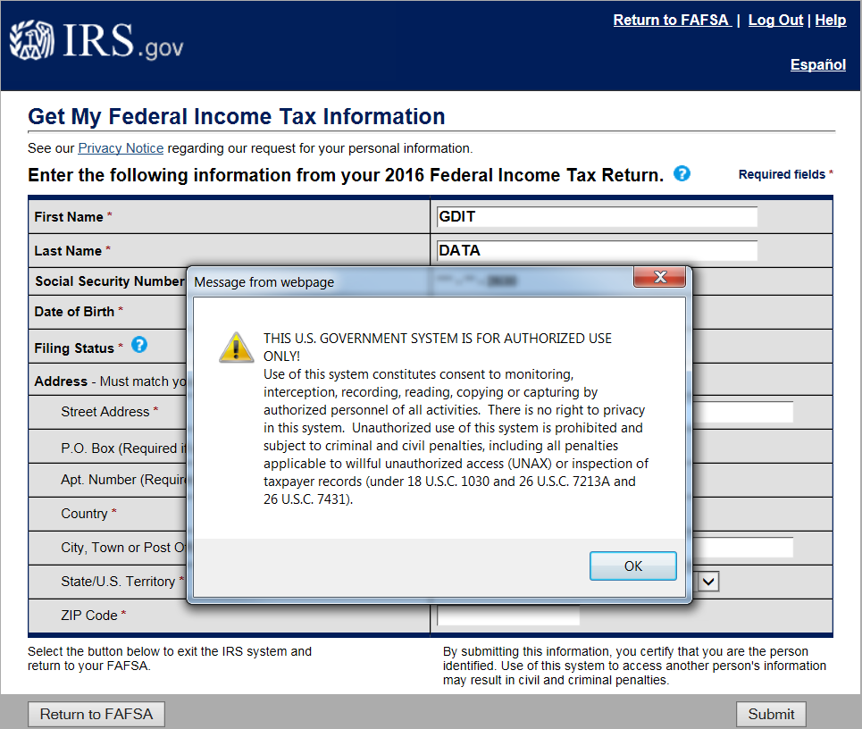
IRS Data Retrieval Process

Slide 26
IRS Data Retrieval Process
What items are brought over from IRS?
Adjusted Gross Income (AGI)
Income Earned from Work (non-joint return)
U.S. Income Tax Paid
Untaxed portions of IRA Distributions
Untaxed portions of Pensions
IRA Deductions and Payments
Tax Exempt Interest Income
Education credits

Slide 27
IRS Data Retrieval Process
New for 2018/2019
EA Announcement dated August 7, 2017 on IFAP discusses changes to the FAFSA IRS DRT User Experience
Helps security and privacy of personal data
Now students/parents will NOT be able to view their tax return information on the IRS DRT web page nor the transferred information
Just a list of the data items that will be transferred
Since transferred information is not displayed, students/parents will be unable to make any corrections to the IRS DRT transferred items on the FAFSA before or after submission.

Slide 28
IRS Data Retrieval Process
Things to keep in mind because of the new change
It is necessary to make changes to how IRA and pension rollovers and income earned from work are reported in the online FAFSA form
Rollovers: If an amount greater than $0 is transferred from the IRS into the Untaxed Portions of IRA Distributions field or the Untaxed Portions of Pensions field in the FAFSA form, the applicant or parent will be required to answer a new question about whether or not that amount includes a rollover. If the applicant or parent answers “yes,” he/she will be required to provide the amount of the rollover in a new entry field. CPS will then subtract the reported rollover amount from the amount of the IRA or Pension distribution that was transferred from the IRS, and the result will be used in the calculation of the applicant’s (EFC).

Slide 29
IRS Data Retrieval Process
Things to keep in mind because of the new change
Income Earned From Work: Because IRS-transferred information will not be displayed, applicants and parents who filed a joint tax return will no longer be able to transfer their combined income earned from work into the FAFSA form from the IRS DRT website. These joint filers will now be required to enter their income earned from work manually. Single applicants and single parents will continue to have their income earned from work transferred from the IRS into their FAFSA form.

Slide 30
IRS Data Retrieval Process
2018–2019 Request Flag Values
Code | Description
Blank | IRS DRT not available in the application method utilized by the student (paper, EDE, FAA Access).
00 | Not eligible to use the IRS DRT and was therefore not presented with the option to use it in FAFSA on the Web.
01 | Presented with the option to use the IRS DRT in FAFSA on the Web and elected to use it, but did not transfer IRS data into the FAFSA.
02 | IRS data was transferred from the IRS and was not changed by the user prior to submission of an application or correction.
03 | IRS data was transferred from the IRS and was changed by the user prior to submission of an application or correction.
04 | IRS data was transferred from the IRS and then changed by the user on a subsequent transaction.
05 | Presented with the option to use the IRS DRT in FAFSA on the Web, but did not elect to use it.
06 | IRS data was transferred from the IRS, but a subsequent change made the student or parent ineligible to use the IRS DRT.
07** NEW | IRS data for the parent was transferred from the IRS, but the IRS indicated that the student or parent filed an amended tax return

Slide 31
IRS Data Retrieval Process
2018–2019 Display Flag Values (some have changed)
VALUE | Student IRS Display Flag | Parent IRS Display Flag
A | Student skipped the income and asset questions – IRS DRT was not displayed | Dependent student has special circumstances or independent student skipped the parent questions – IRS DRT was not displayed
B | IRS DRT was displayed to student | IRS DRT was displayed to parent
C | Tax return filing status not equal to “Already completed” – IRS DRT was not displayed | Tax return filing status not equal to “Already completed” – IRS DRT was not displayed
D | Marital status date greater than or equal to January 2017 – IRS DRT was not displayed | Marital status date greater than or equal to January 2017 – IRS DRT was not displayed
E | First three digits of SSN are 666 – IRS DRT was not displayed | First three digits of SSN are 666 – IRS DRT was not displayed
F | Not Applicable | Non-married parent or both married parents entered all zeroes in SSN – IRS DRT was not displayed
G | Not Applicable | Neither married parent entered a valid SSN – IRS DRT was not displayed

Slide 32
IRS Data Retrieval Process
2018–2019 Display Flag Values
Value | Student IRS Display Flag | Parent IRS Display Flag
H | Student amended his/her tax return – IRS DRT was not displayed | Parent amended his/her tax return – IRS DRT was not displayed
J | Student filed a Puerto Rican or foreign tax return – IRS DRT was not displayed | Parent filed a Puerto Rican or foreign tax return – IRS DRT was not displayed
K | Student is married and tax return filing status is married filed separate return – IRS DRT was not displayed | Parents are married and tax return filing status is married filed separate return – IRS DRT was not displayed
L | Student is married and tax return filing status is head of household – IRS DRT was not displayed | Parents are married and tax return filing status is head of household – IRS DRT was not displayed
M | Conflict between the student’s marital status and tax return filing status – IRS DRT was not displayed | Conflict between the parents’ marital status and tax return filing status – IRS DRT was not displayed
N | Not Applicable | Parents’ marital status is unmarried and both parents living together – IRS DRT was not displayed
Blank | IRS DRT not available (for example, paper, EDE, or FAA Access) | IRS DRT not available (for example, paper, EDE, or FAA Access)

Slide 33
IRS Tax transcript/Tax Return Changes
EA posted January 9, 2019 on IFAP
Changes to 2018/2019 & 2019/2020 Verification Requirements
Institutions may not accept SIGNED COPIES of 2016 or 2017 Income Tax Returns
Tax account information obtained from the IRS through the Internal Revenue Service Data Retrieval Tool (IRS DRT) that has not been changed and a transcript from the IRS or other tax authorities continues to be acceptable documentation
This guidance is effective for all verifications conducted on or after January 9, 2019, regardless of FAFSA processing date

Slide 34
Who’s Signature is required?
EA posted January 9, 2019 on IFAP
Changes to 2018/2019 & 2019/2020 Verification Requirements
The copy of the tax return must be signed by the tax filer or contain the necessary tax preparer information (noted below). When the student's tax return is used, it must be signed by the student (or spouse) or contain the tax preparer's information. When the parent's tax return is used, it must be signed by at least one parent or contain the tax preparer's information.

Slide 35
Who’s Signature is required?
Example of Tax Preparer’s Information
Tax Preparer's Information: If completed by a tax preparer or tax professional, under 34 CFR 668.57(a)(7), the school can accept a copy of the tax return that:
Includes the tax preparer’s Social Security Number (SSN), Employer Identification Number (EIN), or Preparer Tax Identification Number (PTIN); and
Has been signed, stamped, typed, or printed with the name and address of the preparer of the return.
A tax return simply stamped "H&R Block", for example, is not acceptable; it must contain the above information necessary to identify the individual who actually completed/prepared the tax return.

Slide 36
IRS Tax transcript
IRS Tax Transcript Online Tool
SSN, date of birth, filing status and mailing address from latest tax return,
access to your email account,
your personal account number from a credit card, mortgage, home equity loan, home equity line of credit or car loan, and
a mobile phone with your name on the account.
A tax filer who is not able to successfully register will still be able to submit an online or phone request for a tax return transcript to be sent by mail

Slide 37
Irs Tax transcript
Request Method | Where? | Tax Transcript Output Document
 |  | What? | How? | When? | Direct to Third Party?
Online (Get Transcript) | www.irs.gov/transcript | PDF | Electronic request – paper form | 5-10 days | No
Telephone | (800) 908-9946 | Paper | Mailed | 5-10 days | No
IRS Form 4506T-EZ | www.irs.gov/pub/irs-pdf/f4506tez.pdf | Paper | Mailed | 5-10 days | Yes
We do not allow tax transcripts to be mailed directly to our Institution

Slide 38
Irs Tax transcript
In the near future, the transcript will be mailed to the taxpayer’s address of record
In the spring of 2019 the IRS plans to remove the option for requesting third-party receipt of tax information from Form 4506-T and 4506T-EZ. Instead, transcripts will be mailed only to the taxpayer’s address of record
Institutions still interested in receiving tax transcripts directly from the IRS may request to become participants in the IRS’ Income Verification Express Services [IVES] program by registering for e-Services on IRS.gov
An IRS Tax Return Transcript received by a school from a Third Party IVES participant still meets the acceptable documentation standards for verification

Slide 39
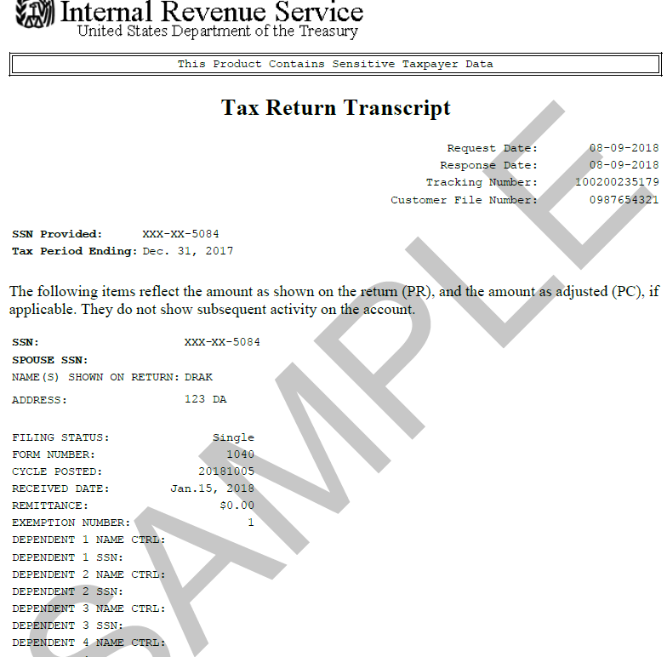
Irs Tax transcript
NEW NEW NEW
Format changes to TRT
Partially redacted personally identifiable information (PII)
Name, SSN and Address

Slide 40
Amended tax returns
If the institution is aware that an amended tax return was filed, to complete verification, the applicant must submit –
Signed copy of 2016/17 Federal Tax Return *and one of the following -*
IRS Data Retrieval Tool information on an ISIR record with all tax information from the original applicable year income tax return;
A transcript obtained from the IRS that lists the tax account information of the tax filer(s); or
A signed copy of the IRS Form 1040 that was filed with the IRS.
NASFAA’s Today’s News dated January 10, 2019

Slide 41
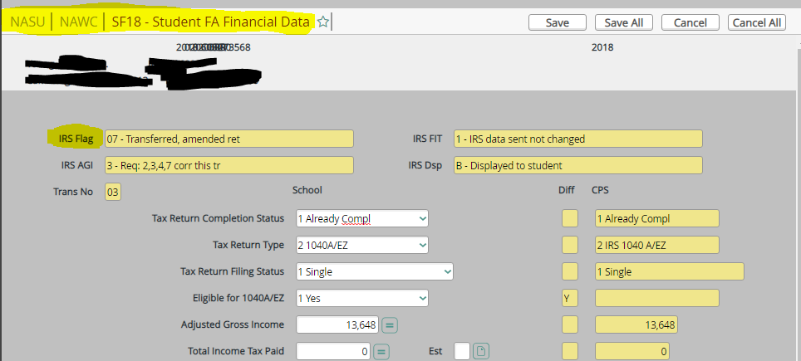
Amended tax returns
In Datatel you can tell if student/parent Amended Tax Return in “NASU” Screen

Slide 42
Identity Theft
As of 2016/2017, a tax filer who is unable to obtain an IRS Tax Return Transcript because of IRS Identity Theft, calls a special IRS group at 1-800-908-4490
Upon verification of identity, the tax filer obtains a paper copy of an alternative document unique to identity theft issues (Tax Return Data Base View (TRDBV))
The TRDBV is an official transcript that can be submitted to the school to meet verification requirements
A statement signed & dated by tax filer indicating they were a victim of IRS tax-related identify theft and that the IRS is aware of the tax-related identity theft
New guidance as of January 9, 2019 -- if the applicant is unable to obtain the TRDBV, then the school may accept a signed copy of the paper tax return (as long as the school has no reason to doubt the identity of the applicant).

Slide 43
Special circumstances
Tax Filers Granted a Tax Filing Extension
As of January 9, 2019 EAnnouncement on IFAP
Institutions may accept a—
Signed statement certifying that the individual—
Attempted to obtain the VNF from the IRS or other tax authorities and was unable to obtain the required documentation; and
Has not filed a 2016 or 2017 income tax return and list the sources of any 2016 or 2017 income, and the amount of income from each source. If self-employed, the signed statement must also include the amount of AGI and U.S. income tax paid for the applicable tax year
Copy of IRS Form 4868, ‘‘Application for Automatic Extension of Time to File U.S. Individual Income Tax Return,’’ the individual filed with the IRS for the appropriate tax year;
Copy of the IRS’s approval of an extension beyond the automatic six-month extension for the appropriate tax year; *and*
Copy of IRS Form W–2 for each source of 2016 or 2017 employment income received or an equivalent document.

Slide 44
Special circumstances
Foreign Tax Returns
Guidance also applies to foreign tax filers. That is, a signed copy of the foreign tax return can be accepted in place of a foreign tax transcript, regardless of whether or not there is a fee to obtain the foreign tax transcript.

Slide 45
Special circumstances
Rollovers
If DRT transfers a non-zero amount into the untaxed pension or IRA distribution field, applicant will be able to report amount of rollover and Central Processing System (CPS) will subtract it
The IRS Data Field Flag will be “2” Field changed by user prior to submission of application
To complete verification of this item, collect a signed statement certifying that the untaxed pension or IRA distribution contained a rollover

Slide 46
Comment Codes 400/401
Since students and parents using the IRS DRT can no longer view the information transferred from the IRS, this has eliminated the inclusion of edits that may have identified potential issues. Instead, SAR/ISIR Comment Codes of 400 and/or 401 have been added.
Resolution is required
400 – Issues related to the reporting of parental data
401 – Issues related to the report of student data

Slide 47
Comment Codes 400/401
Potential Reasons for Comment Codes 400/401
Parent and/or student is a tax filer and the AGI is zero, but the income earned from work is greater than zero.
Parent and/or student’s Total of Additional Financial Information is greater than the AGI transferred from the IRS.
Parent and/or student reported any item from the FAFSA list of Untaxed Income that is equal to or exceeds the AGI transferred from the IRS.

Slide 48
Comment Codes 400/401
Common Issues for Comment Codes 400/401
Parent information has been duplicated in the student section of the FAFSA
Parent 1/Parent 2 or Student/Spouse income earned from work is identical.
Income reported for 201X is significantly different than amount reported for 201X.

Slide 49
Comment Codes 400/401
Resolutions for Comment Codes 400/401
Review the information reported on the FAFSA to determine if it meets any of the three criteria previously described. These must be resolved.
Review FAFSA information for potential errors.
Request applicable documentation.
Simulate a change in FAA Access to see the reason for being selected flagged.
Make a note in the student’s file regarding the resolution of 400/401.

Slide 50
Conflicting information
What is Conflicting Data under the regulations?
668.54(a)(2) — If an institution has reason to believe that an applicant’s FAFSA information is inaccurate, it must verify the accuracy of that information.
668.16(b)(3)—An institution must communicate to the individual designated to be responsible for administering Title IV, HEA programs, all the information received by any institutional office that bears on a student's eligibility for Title IV, HEA program assistance.
668.16 (f) —An institution must develop and apply an adequate system to identify and resolve discrepancies in the information that the institution receives from different sources with respect to a student's application for financial aid under Title IV, HEA programs

Slide 51
Conflicting information
Is it conflicting information? If so, what documentation will resolve it?
A student is not selected for verification, the IRS transcript is on file and information conflicts with items on the FAFSA.
Tax transcript shows parent single head of household and on the FAFSA/ISIR shows the same person as married.
Parent or student report on their FAFSA and signed a verification worksheet that they will not file an IRS 1040. You have reason to believe that they would have been required to file a U.S. Income Tax Return, as the amount of reported income is greater than or equal to the minimum amount required to file as indicated in the instructions provided on the 1040.
School receives Profile from CSS. Student reports a specific amount in untaxed income; FAFSA reports a different amount (If the school receives the CSS Profile, it must ensure that information contained there does not conflict with other documents received by the school).
Admissions information received impacts student eligibility (i.e., student accepted into a non degree program, student received scholarship from high school, etc.)

Slide 52
Conflicting information
Examples of good practices for resolving Conflicting Data
Assets reported on the FAFSA are $0 or low but significant interest and dividend income or capital gains are reported on the U.S. Income Tax Return.
$0 income reported with no explanation as to how the student/parent/family can live on $0 income (Your institution may want to consider developing an expense vs. resource form to review $0 to low income reporting for the Calendar Year January–December).
Address reported by student/parent (i.e., if parents are divorced and the address on the student’s tax return does not match the address of the custodial parent’s tax return). Or the address doesn’t match the state of residence as listed on the FAFSA. (Your institution may want to consider obtaining a written explanation to determine residency).
If the student or parents reported business/farm net worth but didn’t file a schedule C or Form 1120 or just didn’t supply it to the school (Your institution may want to consider requesting additional documentation from the student or parent).
Box 14 information from W-2 (Determine if the dollars represented are untaxed income not previously reported).
Questionable Dependency Status – Student selects “Ward of Court”, “Legal Guardian”, “Emancipated Minor”, “Foster Care”, or “orphan/Adopted”, “Homeless” or “at risk of Homelessness” as basis for Independent Status - Obtain PROOF and/or documentation of such status
REMEMBER: You always have the ability to ask for whatever information you need any time that you think there is a problem.

Slide 53
2019-2020 VERIFICATION
NO KNOWN CHANGES!!

Slide 54
Document…document…document
Here is what Chesapeake collects ::
IRS Tax Transcript for given year for both student/parent/spouse (1040X if needed)
W2’s for students, parent(s), spouse(s) for given year
Non-Filing Form
Verification Worksheet
High School Dip/GED/Equivalent
Academic Transcripts
Birth Certificates/SS Card
Citizenship

Slide 55
Consider….
Brittani is 23 and her ISIR shows she has 2 dependent children and no income or benefits. She graduated from a NJ high School, and reports her state of residency as DE. Her verification code is V1.
Brittani lives with her children’s father, Jordan. Turns out, Jordan filed taxes in 2016 and 2017 as “Head of Household” with 3 dependents – Brittani and the 2 children.
Jordan carries the children on his health insurance, and Brittani is still covered by her parent’s insurance.
Is Brittani really Independent?
She actually has NO dependents
She must correct her FAFSA to show her parental data and signatures
She might not qualify for “In-State” tuition and state aid

Slide 56
CONSIDER…
Julius, 18, has lived with his grandparents since he was born and has never had contact with his parents. His parents both have substance abuse issues, and no one really knows where they are – or if they are actually still alive.
Julius’s grandparents have no legal documentation concerning custody or guardianship, but HAVE claimed Julius on their taxes and supported him since he was born. His FAFSA has no EFC but is flagged for verification code V1.
Who should be reported on his FAFSA as the “parent or guardian”?
Lacking LEGAL basis, the Grandparents CANNOT report.
The FAA might consider a DEPENDENCY OVERRIDE, using the grandparent’s basic support as Julius’s “other untaxed income”, “gifts or bills paid” on his behalf.
Documentation might be a letter from the Grandparents, primary and/or secondary school records showing the Grandparents as Emergency Contacts and/or responsible/custodial parent, and letters from a teacher, counselor, clergy, or medical person who is aware of Julius’s history and situation.

Slide 57
CONSIDER…
Albert, 20, filed his FAFSA as an independent student with a 2016 income of $3,200, and has a verification code of V1.
He answered yes to “Legal Guardianship” as his basis for his Independent status. Albert’s parents are both active military, and when Albert was a High School Junior, BOTH his parents were deployed at the same time. Albert went to live with his Aunt, who was given Temporary Legal Guardianship over Albert for the duration of the parent’s deployment.
Albert brings a document signed by his parents to support his independent status.
Is Albert REALLY an Independent Student?
The FAFSA instructions and directions refer to “COURT APPOINTED” Legal Guardianship ONLY.
Albert must correct his FAFSA to add his parental data and signatures

Slide 58
QUESTIONS???

Slide 59
Group Discussion
What are you doing on your campus?
Which students are you verifying?
Only those selected by CPS?
Institutionally selecting additional students?
If so, what criteria are you using to select?
Are you verifying additional items or just those required by the tracking group?
What are you collecting for Non-Filing Students
Schools have flexibility on the format of the written statement, but it needs to be signed by the non-filer. For example, the non-filer could simply submit a signed attestation, or the school could provide a form with standard language about attempts to obtain the VONF that the non-filer only needs to sign.

Slide 60
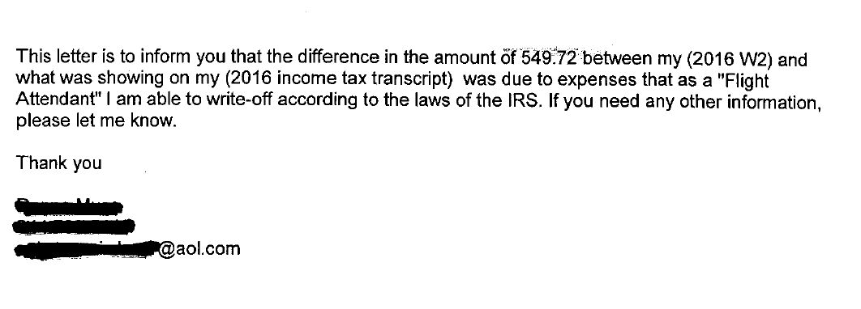
Case Studies
Student ABC
See handout
Missing information?

Slide 61
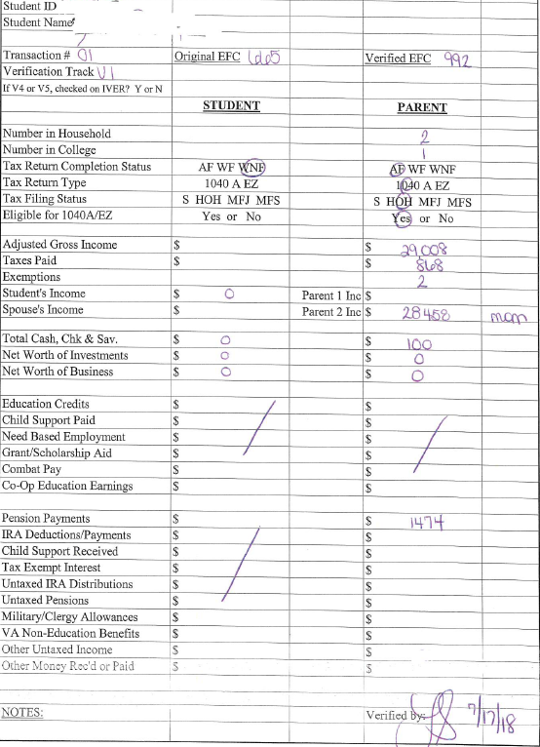
Case Studies
Student ABC
Student ABC
Verification Results

Slide 62
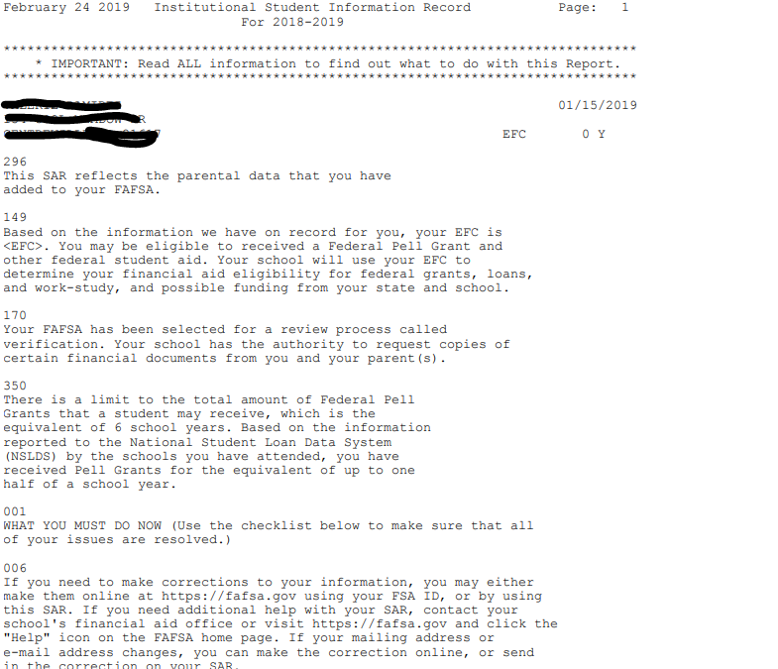
Case Studies
Student XYZ

Slide 63
Case Studies
Student XYZ
Reported on the FAFSA
2 in household; 1 in college
Student Income
AGI $2,655
Income tax paid $400
Exemptions 0
Income Earned from Work $0
Parent Income
AGI $3,600
Income tax paid $0
Exemptions 1
Income Earned from Work $3,600
Education Credit $0

Slide 64
Case Studies
Student XYZ
Dependent Verification Worksheet
2 in household; 1 in college
Assets on both sides $0
Lets look at the file & results

Slide 65
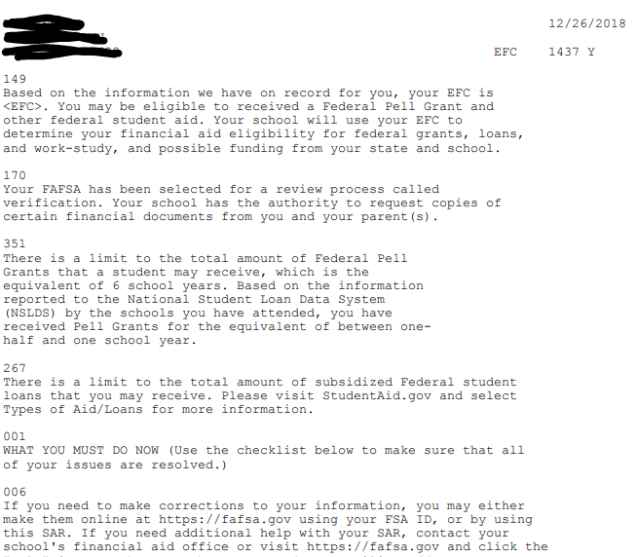
Case Studies
Student MNO

Slide 66
Case Studies
Student MNO
Reported on the FAFSA
5 in household; 3 in college
Student Income
Will Not File
Income Earned from Work $0
Cash, Savings & Checking $2,151
Parent Income
AGI $38,033
Income tax paid $0
Exemptions 5
Income Earned from Work $0 (for P1 & P2)
Other Untaxed Income $5761

Slide 67
Case Studies
Student MNO
Let’s look at the file & results

Slide 68
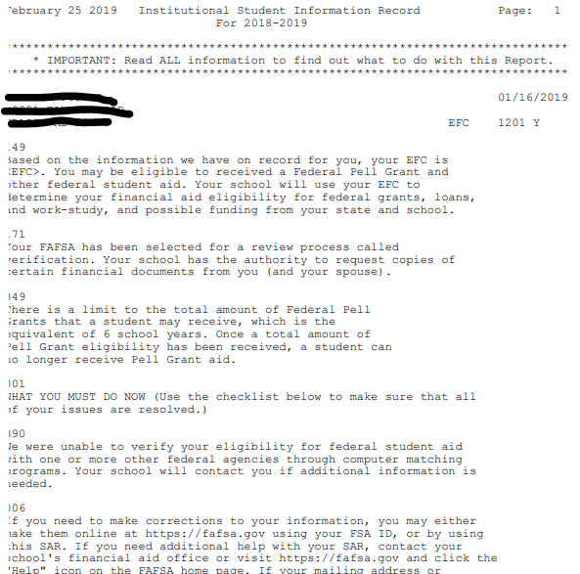
Case Studies
Student QRS

Slide 69
Case Studies
Student QRS
Reported on the FAFSA
2 in household; 1 in college
Separated 8/2018
Student Income
AGI $52,000
Income Tax Paid $9,000
Exemptions 0
Income Earned from Work $56,000
Cash, Savings & Checking $14,000
Child Support Paid $238

Slide 70
Case Studies
Student QRS
Let’s look at the file & results

Slide 71
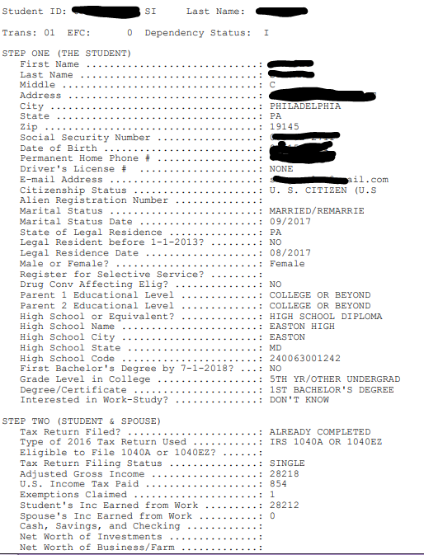
Case Studies
Do you see anything wrong with this?

Slide 72
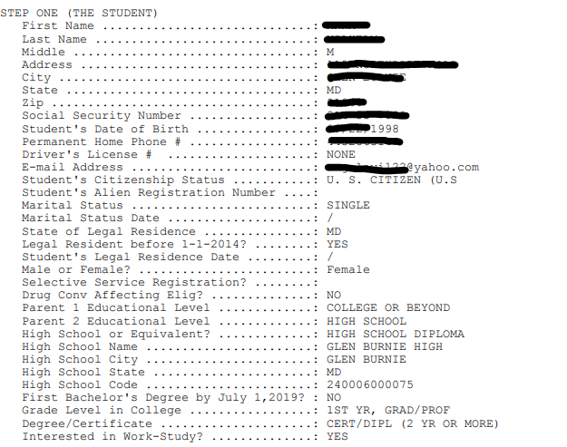
Case Studies
Do you see anything wrong with this?

Slide 73
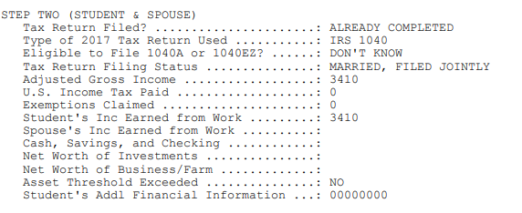
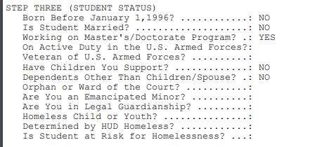
Case Studies
Do you see anything wrong with this? (cont)

Slide 74
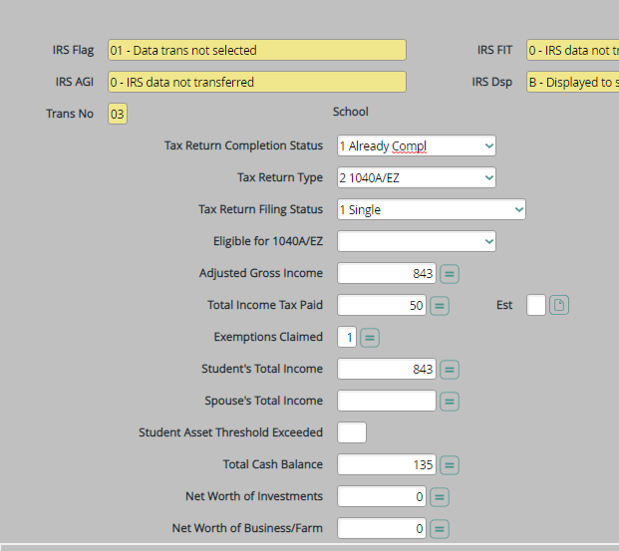
Case Studies
Conflict ??
Dependent student gives you a “Student Non-Filing Form” stating they did not work in 2016 or file a tax return in 2016
FAFSA has this

Slide 75
CONTACT INFO:
Laura Shahan
Assistant Director of Financial Aid
Chesapeake College
lshahan@chesapeake.edu
Angie Hovatter
Director of Financial Aid, Employment & Scholarships
Frostburg State University
ahovatter@frostburg.edu

